Slide 1
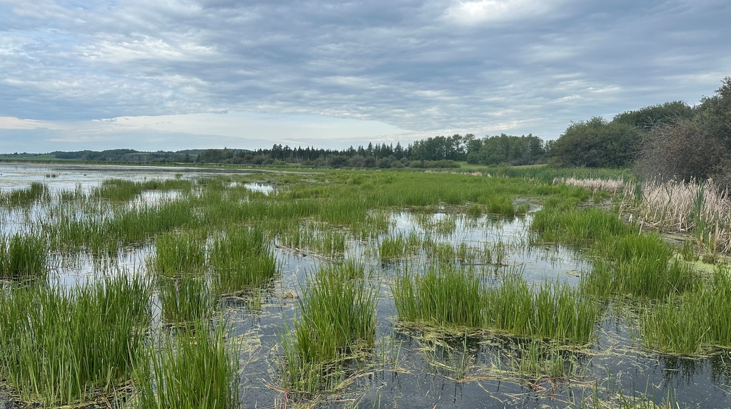
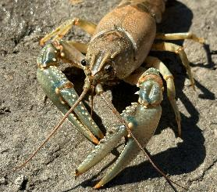
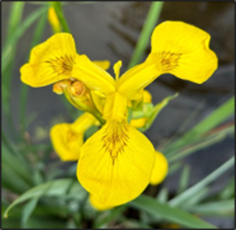
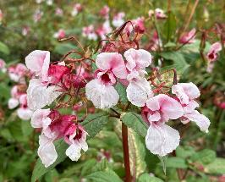
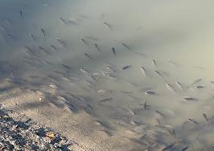

Aquatic Invasive Species - LILSA
Kallum McDonald, MSc
Megan Evans, MSc
Nicole Kimmel

Slide 2
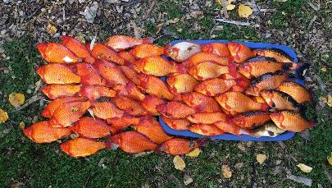
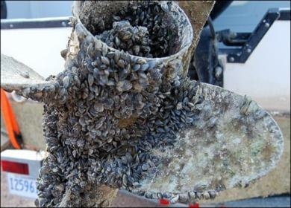
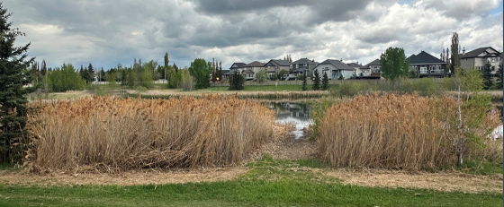
What are Aquatic Invasive Species (AIS)?
Foreign organisms that live in aquatic, wetland, and riparian habitats.
Threaten ecosystem health in lakes, rivers, stocked ponds, wetlands.
Outcompete native species for food and habitat.
Threaten vulnerable/at risk species.
Inhibit aquatic recreation (boating, fishing, swimming, etc.)
Invasive mussels may force the closure of waterbodies.
Clog water intakes/pipes.
Reduce shoreline property values.
Reduce biodiversity.
Disrupt aquatic food webs.
Alter hydrology and degrade wetlands.
Harm fish, including provincially-funded stocked ponds.

Slide 3
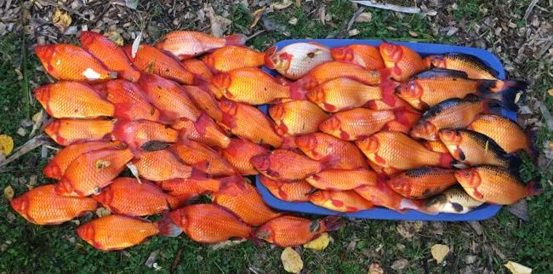
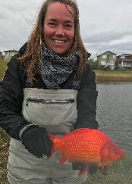
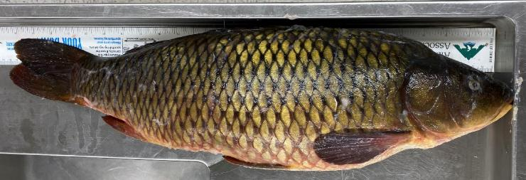
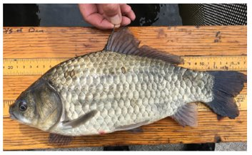
Prussian & Common Carp
East Pit Lake - Common Carp.
Spring Lake – Prussian Carp.
Bucket Biology suspected – illegal live transfer and release.
Highlight need for greater education efforts with fishing community.

Slide 4
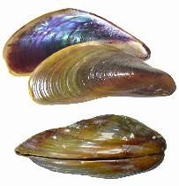
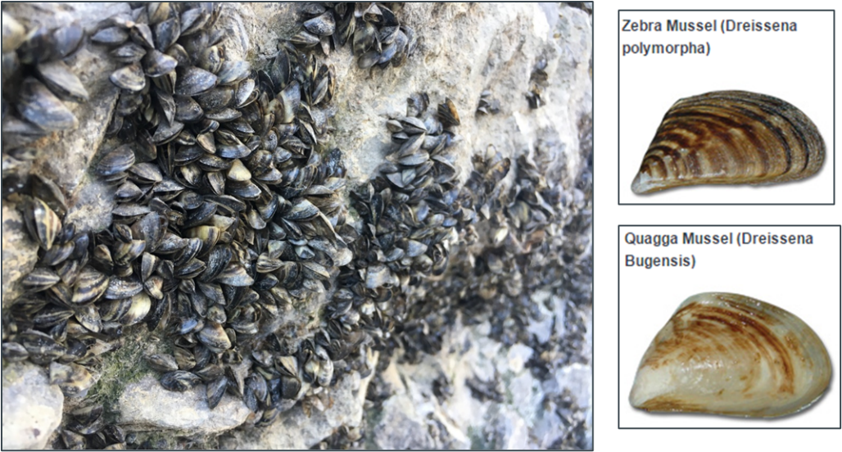
Invasive Bivalves (Mussels + Clams)
Golden Mussel – 3rd invasive freshwater mussel in North America, announced in October 2024.

Slide 5
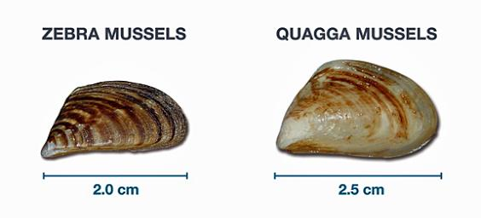
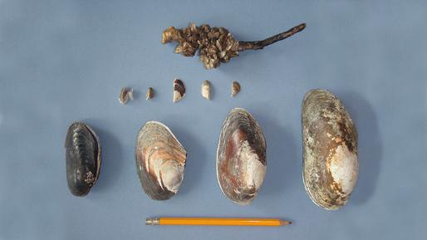
Invasive Mussels - Impacts
Severe maintenance costs for water-dependent infrastructure (municipal water, power generation facilities, irrigation).
Devastate photosynthetic level of aquatic food webs, decimating food sources for higher species.
Radically alter waterbody nutrient dynamics.
Increased water clarity enhances growth of aquatic plants, which may hinder aquatic recreation.
Notes:
Zebra and quagga mussels –introduced to NA in ballast water from ships in the great lakes in 1986
They are filter feeders (eating the plankton and algae suspended in water. One mussel can filter a litre of water in one day, drastically upsetting the ecosystem and taking this important food source away from the native species that rely on it.
Can make the water more clear (by filtering our suspended sediments, but this results in more sunlight penetrating the water, resulting in excessive aquatic plant growth and can result in toxic algal blooms.
One mussel can produce 1 million eggs in a season
Larvae are microscopic and free floating in water
We have native mussels in AB but an attached mussel is an invasive mussel
Adults attach themselves to any hard surface, clogging intake pipes, water treatment facilities, etc.

Slide 6
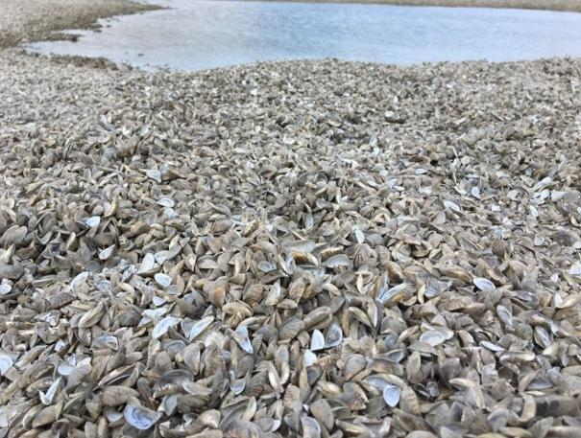
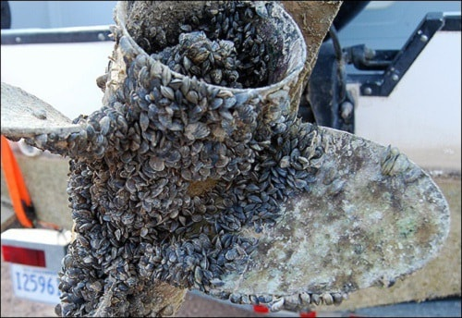
Invasive Mussels
https://globalnews.ca/news/5220880/winnipegs-zebra-mussel-problem-can-be-tackled-but-comes-with-big-price-tag-u-s-researcher/
Wabamun Lake Near-Miss in October 2024.
Vigilance is key! Clean Drain Dry you boat/gear and check your lakes!
Notes:
Cost Canadians $ 7 billion since their introduction in 1986 (most costs from the Great Lakes).
AB’s irrigation infrastructure is most at risk, almost 8,000 kms of conveyance works including pipelines and canals
Would cost $75 million annually in Alberta
https://www.invasivespeciescentre.ca/wp-content/uploads/2023/06/Economics_2023_FINAL_SMALL.pdf

Slide 7
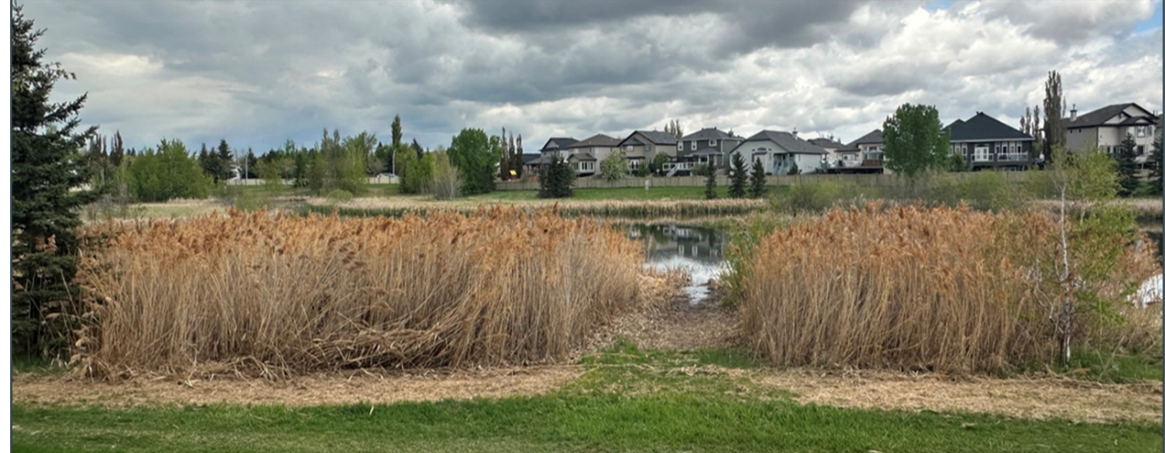
European Reed / Invasive Phragmites
Railways and highways are major vectors – keep an eye out!

Slide 8
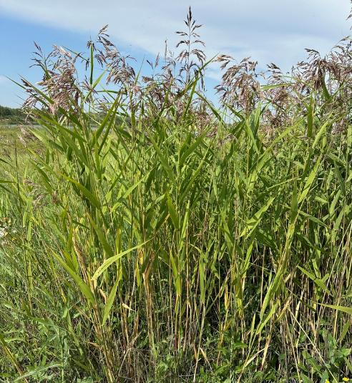
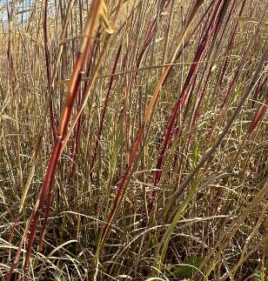
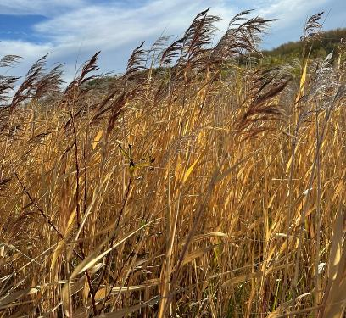
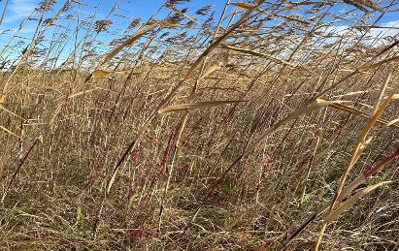
American Reed / Native Phragmites
Sporadic at LI and LSA, large patch near West Cove.

Slide 9
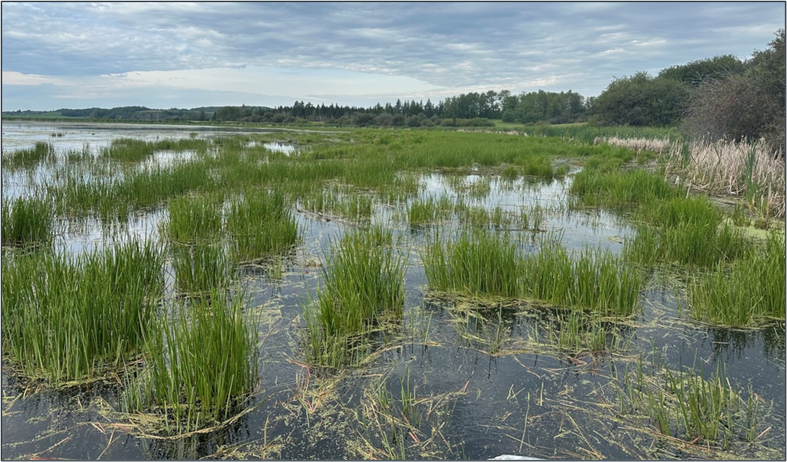
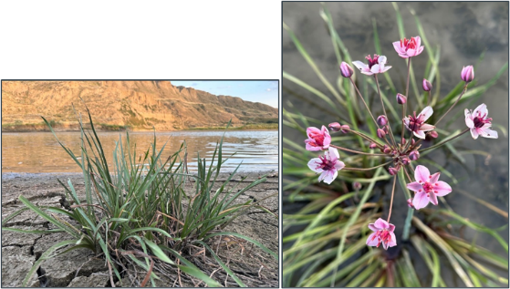
Lake Isle, summer 2024
Flowering Rush

Slide 10
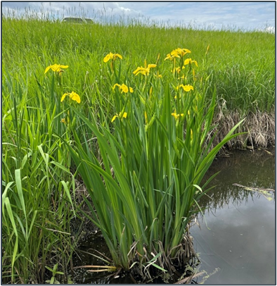
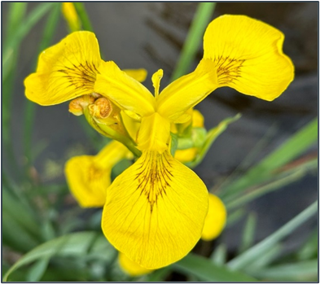
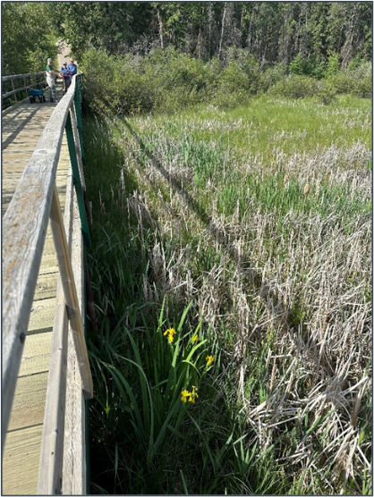
Pale Yellow Iris (Yellow Flag Iris)
Large infestation in Stony Plain.

Slide 11
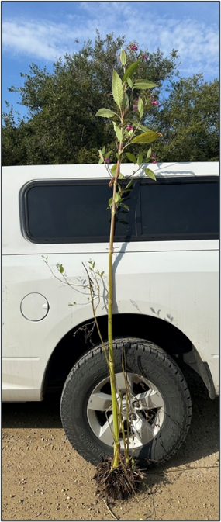
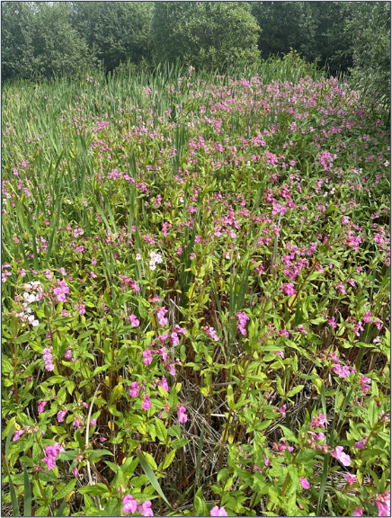
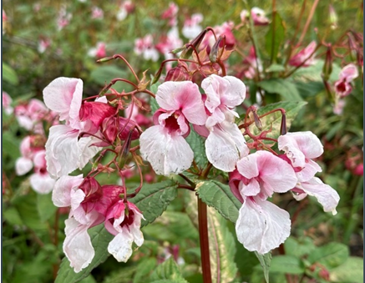
Himalayan Balsam
Large infestations around Wabamun lake.
Small patch found at LSA – end of RR40.
Small patch on Rock Island, LSA.
Alberta Beach boat launch – none found!
Mystery patch somewhere along Lake Isle – if found, please report!

Slide 12
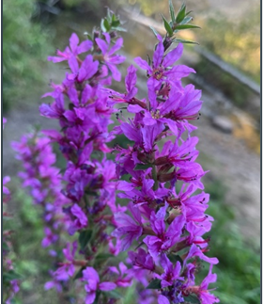
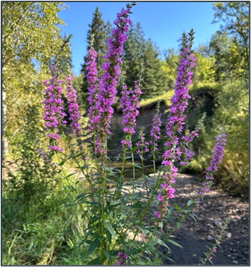
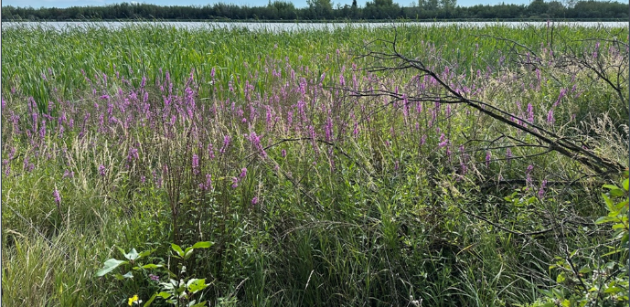
Purple Loosestrife
Large infestation at Wabamun lake.

Slide 13
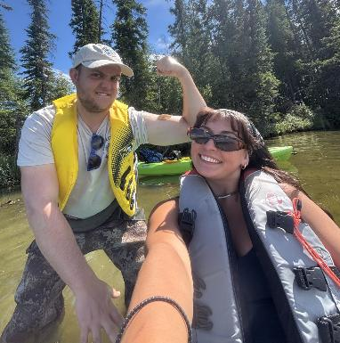
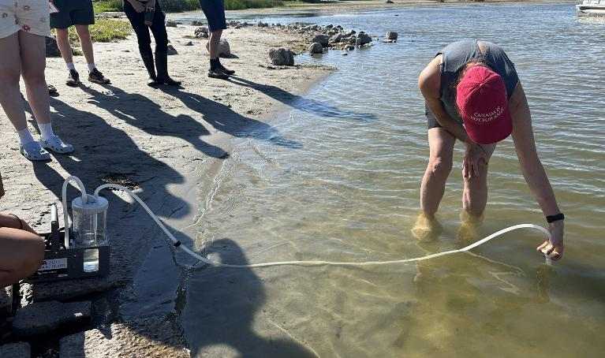
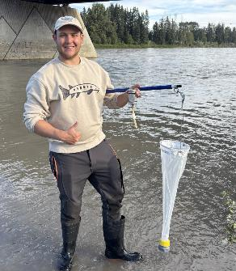
AIS Monitoring
Shoreline surveys
eDNA testing
Plankton tow netting
*Substrate samplers?

Slide 14

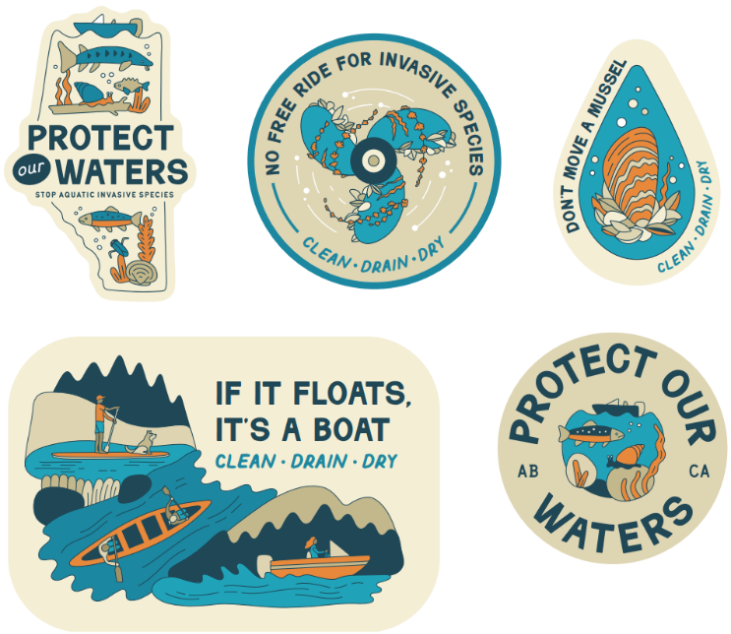

Slide 15
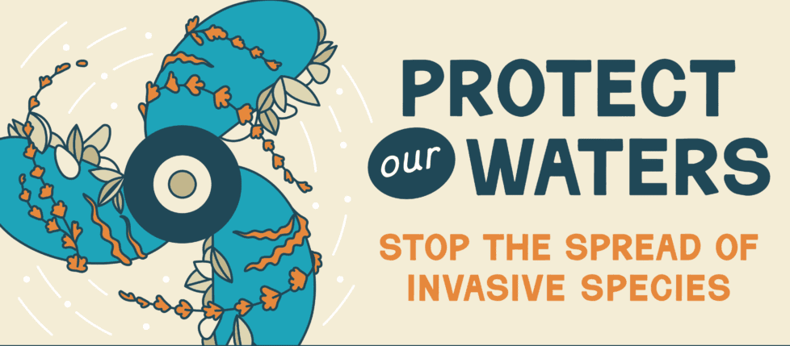
How you can help protect lakes and rivers:
Clean Drain Dry your watercraft and gear!
Don't Let It Loose – do not move or release live fish and aquarium contents.
Check your dock, beaches, and boats for attached mussels or mussel shells.
Document aquatic and shoreline organisms on iNaturalist.
Report suspected invasives: epa.ais@gov.ab.ca, EDDMapS, ais@abinvasives.ca, 1-855-336-BOAT (2628), or text me: 780-830-6391

Slide 16
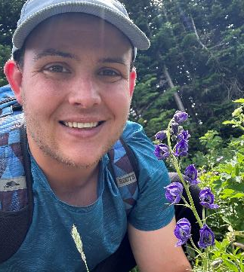
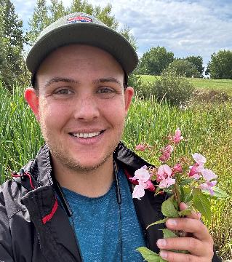
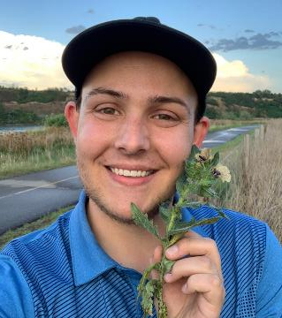
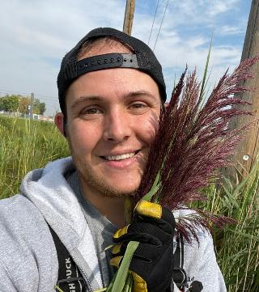
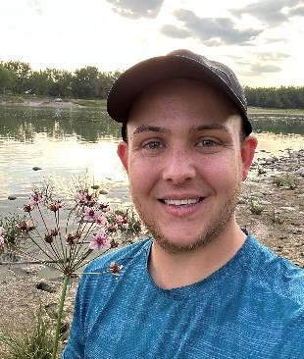
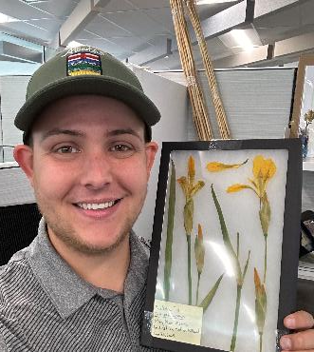
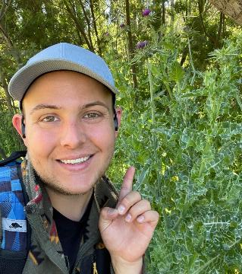
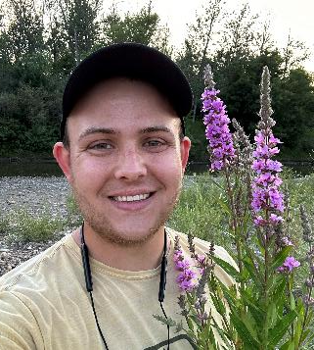
Thanks for listening! Questions? ais@abinvasives.ca

