Slide 1


2026 Summer LakeKeepers
Presenter: Stephanie Ewasiuk
Lake Isle and Lac Ste. Anne Stewardship Society AGM August 8, 2026

Slide 2

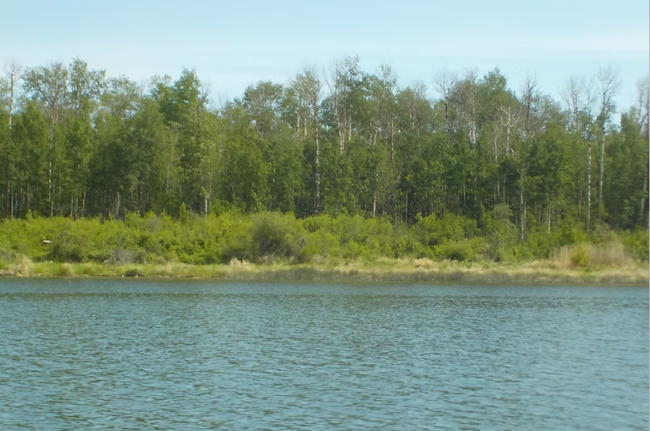
Program Overview
Alberta Lake Management Society’s Summer LakeKeepers enables volunteers to independently monitor lakes for parameters important to ecological health.
Encourage citizen engagement, foster education and understanding for healthy lakes
Reporting and interpretation by ALMS provides evidence-based data. This, along with local and traditional knowledge, further supports lake management, conservation, and stewardship decisions.

Slide 3
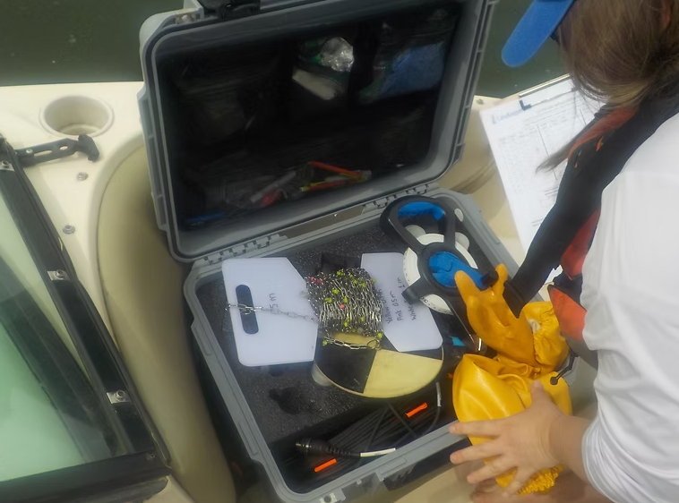
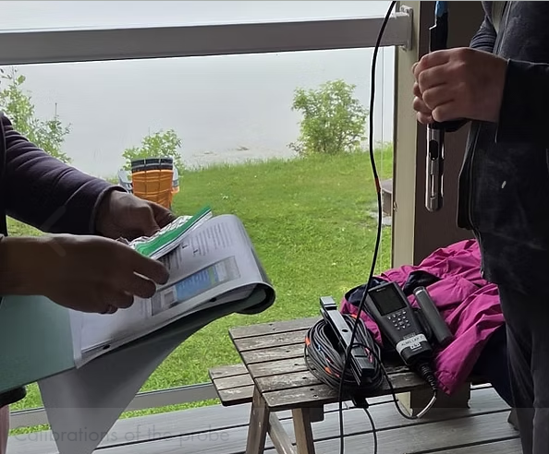
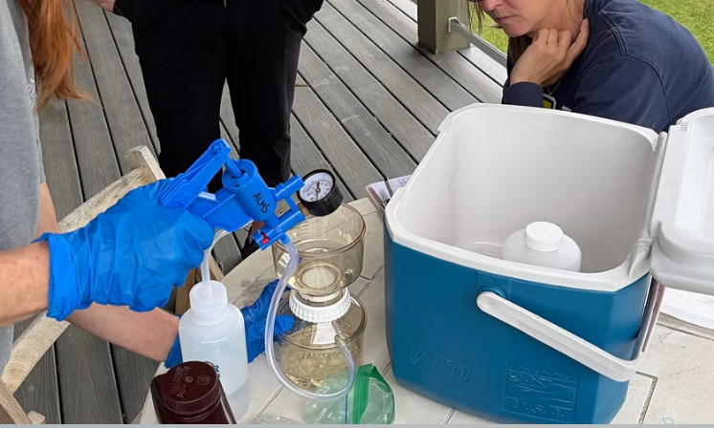
ALMS Field Kit
Consisting of:
Chlorophyll-a Filtration Kit
YSI Pro ODO meter for temperature and dissolved oxygen
Tape and Weight
Secchi Disk
Field sheets
Field Manual
Sample bottles

Slide 4
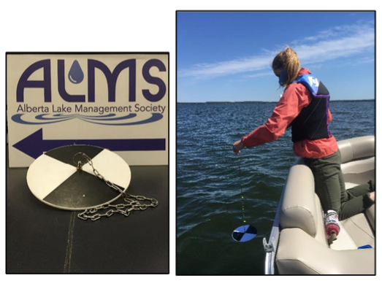
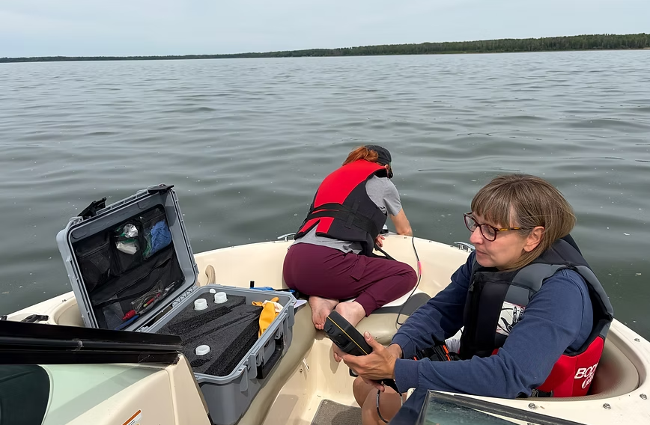
Physical Testing Parameters
Secchi Depth is the easiest and most widely used test to measure lake water clarity. Two times the depth equals the depth to which there is enough light for photosynthesis (euphotic depth).
Water clarity is influenced by suspended materials, both living and dead, as well as dissolved colored compounds in the water column. In early spring, lake water can become turbid (cloudy) from silt transported with runoff into the lake. Lake water usually clears in late spring but becomes more turbid as algae growth increases during the summer.
Temperature: Water temperature in a lake dictates the behaviour of numerous chemical parameters responsible for water quality. We will measure temperatures at 0.1 m, 0.5 m, and every meter below the surface, until 1m off the bottom.
Water Depth: Full lake depth puts the profile readings into context.

Slide 5
Chemical Testing Parameters
Chlorophyll-a: Pigment used by algae and cyanobacteria for photosynthesis. Indicator of algae abundance.
Microcystin: A toxin produced by cyanobacteria that can cause liver damage if ingested. Common in Alberta lakes; recreational guideline set at 10 µg/L.
Total Phosphorus: A key nutrient driving algae and cyanobacteria growth. Even small increases can trigger blooms, affecting water clarity and recreational use. Sources include sediments, waste, and fertilizers.
Isotopes: Variants of elements with differing neutron counts. Hydrogen and oxygen isotopes in water help trace evaporation, groundwater inflow, and water balance in lakes.
Dissolved Oxygen (DO): Measures oxygen available for aquatic life, in mg/L and % saturation. Often drops sharply at the thermocline (where water temperature changes quickly with depth).
Conductivity: Measures water's ability to conduct electricity based on dissolved salts/minerals. Reflects natural processes (e.g., rock weathering) or human impacts (e.g., road salt, runoff); changes can signal shifts in water quality.

Slide 6

Next Steps
Data will be uploaded and made publicly available via DataStream. This database is an initiative of the Gordon Foundation, supporting community involvement in water stewardship
An end-of-year report will be compiled by ALMS, providing an easy-to-read summary of results and interpretation of trends using historically available data.
Looking for volunteers interested in the Winter LakeKeepers program! Please contact LILSA with your interest.

Slide 7
A huge thank you to:
Kurstyn with ALMS for training and guidance.
Michelle D. with LILSA for taking many photos of our experience.
Alicia D., LILSA member, for providing her boat and transporting samples back to ALMS.

Slide 8
Resources
Alberta Lake Management Society: www.alms.ca/summer-lakekeepers http://alms.ca/wp-content/uploads/2026/01/Isle_2024_FINAL.pdf
Gordon Foundation’s DataStream: https://gordonfoundation.ca/initiatives/datastream
LILSA: lilsawaterquality@gmail.com

